Slide 1
Wangetchi Mutu
Nafisah Cabbell

Slide 2
Biography
Wangechi Mutu
(1972 - )
Nairobi, Kenya
Born and raised in the urban portion of Africa
Could not relate to the western generalization of African countries or cultures.
Was 19 when she moved to US
Trained sculptor and anthropologist

Slide 3
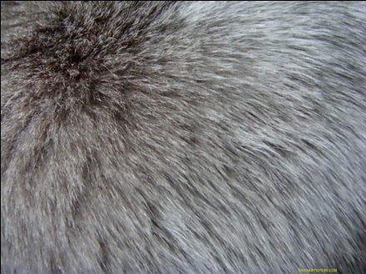
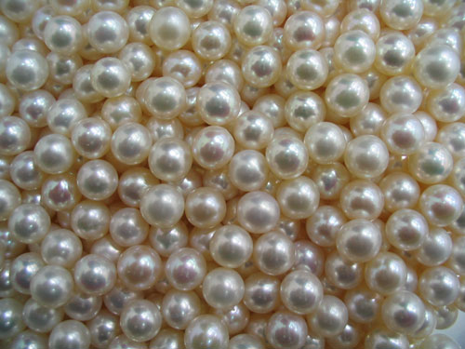
Art Style
Fur
Painting
Collage
Materials
Significance
Glitter
Soil
Pearls

Slide 4
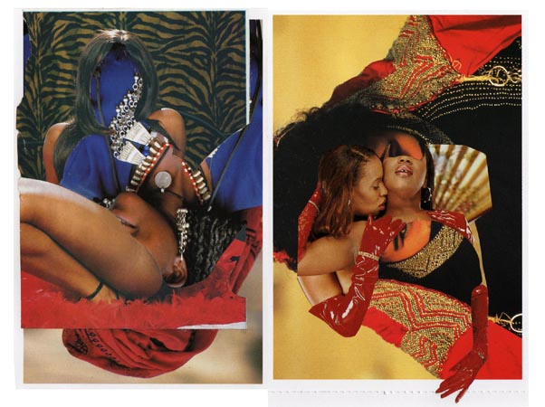
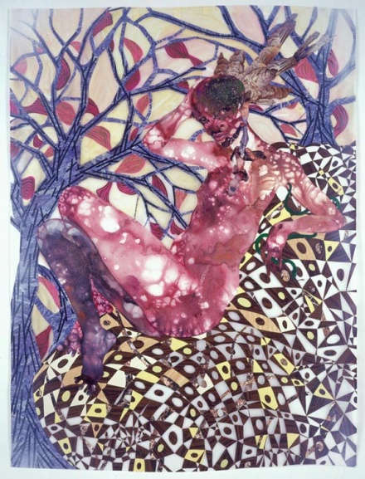
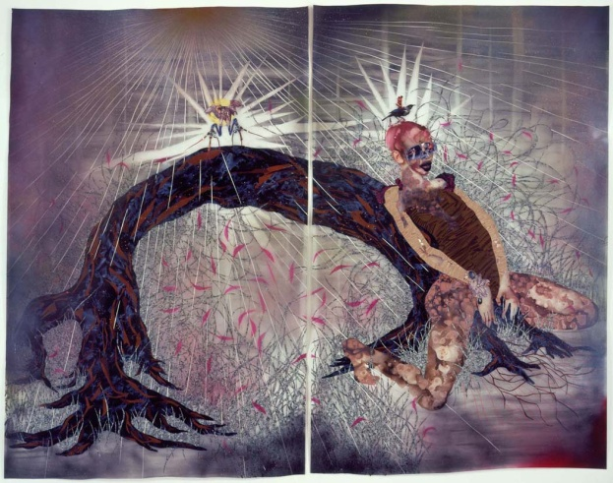
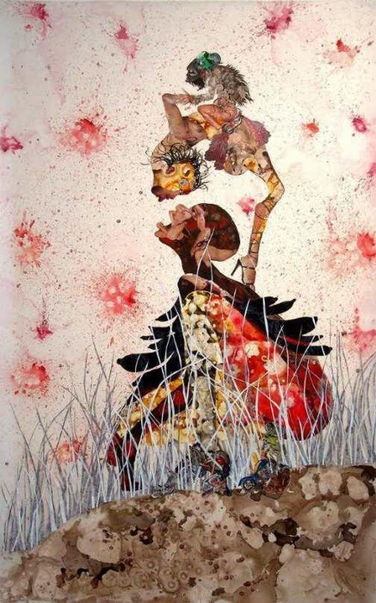
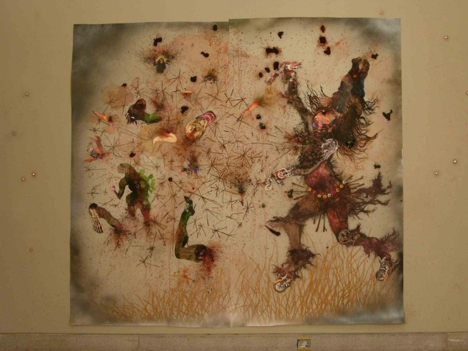
Feminist Theory
Sexualized imagery
Preying Mantra, 2006
The Ark Collection, 2006
A Shady Promise, 2006
Dismemberment
Dismantling the Little Empire Inside of You, 2007
Patriarchal white male gaze
Misguided Little Unforgivable Hierarchies, 2005

Slide 5
Legacy
Voice & Self Representation
http://www.youtube.com/watch?v=fqCH8uFdCG8

Slide 6
Bibliography
Brooklyn Museum. Elizabeth A Sackler Center for Feminist Art: Feminist Art Base: Wangechi Mutu. http://www.brooklynmuseum.org/eascfa/feminist_art_base/gallery/wangechi_mutu.php?i=1454.
Brandstetter, Anna-Maria. “Violence Trauma Memory.” Murambi Memorial Centre. April, 2004. 127-133. http://vkc.library.uu.nl/ci/research/list/seminarprogram/attachments/22/Branstetter Violence Trauma Memory.pdf
Cole, Serena. Artists I Love: Wnngechi Mutu. Artists and Astronauts. November 21, 2010. Blog Spot. http://artistsandastronauts.blogspot.com/2010/11/artists-i-love-wangechi-mutu.html.
Evans, Matthew and Koemer von Gustorf, Oliver. “’We Categorize What We’re Afraid of,’ an Encounter with Wangechi Mutu.” Deutsche Guggenheim Magazine. Spring 2010: 4-13. Print. http://www.deutsche-guggenheim-berlin.de/dg/assets/pdf/dgm11pdf
Regalia and Repetition. Ed. Deborah Karpman. May, 2009. Department of Art, Art History, and Archetecture. University of Massachusetts Amherst. 12 April 2011. http://shoolarworks.umas.edu/cgi/viewcontent.cgi?article=1380&context=thesis&sei
Rhyme and Dissonance: Shared Strategies in Works by Lorna Simpson, Wangechi Mutu and Leslie Hewitt. Ed. SoniaLouise Davis. April, 2010. Department of Honors in African American Studies. Wesleyan University. 24 February 2011. http://wesscholar.wesleyan.edu/cgi/viewcontent.cgi?article=1590&context=etd_hon_thesis
Wangechi Mutu: Feminist Collage and the Cyborg. Ed. Nicole R. Smith. December, 2009. Art and Design Thesis. Paper 51. 16 March 2011. http://digitalarchive.gsu.edu/art_design_thesis/51
Wangechi Mutu This You Call Civilization. YouTube. ArtGalleryofOntario. March 4, 2010. http://www.youtube.com/watch?v=fqCH8uFdCG8

